Slide 1

Science Forward: philosophy of Science
Fall 2025
Instructor Hildegaard Link P.E. PhD

Slide 2
Critique of Science & the Origins of the Critique
The rationality and logic of science
Logical Positivists emphasized logic (both deductive and inductive) and the importance of empirical data.
Scientific Method aims to get us closer to the truth by allowing us to collect unbiased data.
Inference to the best explanation is an inductive process that tells us how to rationally choose the best theory between competing explanations.
Confirmation is a process that allows us to feel confident that our theories are getting closer to the truth.

Slide 3
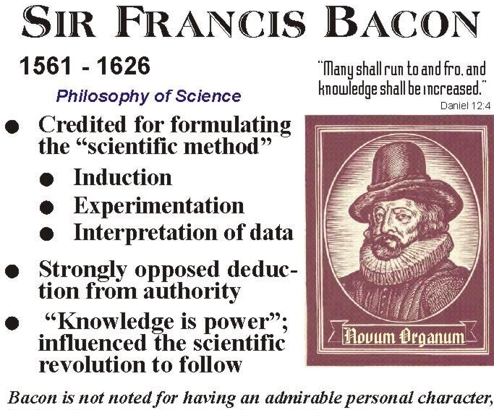
Francis Bacon & the Scientific Method
Generally credited with bringing the Scientific Method to Europe.
Proposed Reproducible Experiments as the basis for knowledge (as opposed to ecclesiastic inspiration)

Slide 4
Normal Science – Popper and Falsifiability
Empirical (normal) science use primarily inductive
methods (singular universal statements )
Knowledge is created by conjecture and criticism
Inductive inference can attain some degree of reliability or of probability.
“probabilistic inferences”
Seeking theories with a high probability of being true was a false goal that is in conflict with the search for knowledge
Scientific statements can only attain continuous degrees of probability whose unattainable upper and lower limits are truth and falsity.
Falsification is the criteria to check if a
theoretical system belongs to empirical
Science
Basic statements or singular statements
are falsifiable
A theory is falsifiable if the class of its
potential falsifiers is not empty, as any
theory can be divided into the classes of
potential falsifiers and permits

Slide 5
Critiques of Science !
Kuhn & Structure of Scientific Revolutions
Normal Science and “Revolutionary Science”
Science does not proceed along a linear pathway but grows in revolutions and explosions
Post Normal Science - Funtowicz &Ravetz
Science is Not Value Free
Used in service of an outcome selected via value judgements
Integrates local knowledge vales and interests
Useful for cases where "facts are uncertain, values in dispute, stakes high and decisions urgent"

Slide 6
Kuhn
1) Science is influenced not just by independent logical norms, but also by human history and personalities (duh!)
2) Science has a specific structure that is composed of two distinct kinds of processes: (i) normal science, and (ii)revolutionary science.
3) of “paradigm shifts,” and the claim that paradigms are incommensurable and that the move from one paradigm to another is not rational.
4) Scientific truth is relative. There is no such thing as objectivity. There is no ultimate standard. There is no cumulative growth of scientific knowledge.
Ooooh pretty grim what do you all think ?

Slide 7
Kuhn
Normal Science & Periods of Scientific Revolution
How do these modes differ from each other
How are they connected to each other.
What processes move scientists from normal science to a revolution?
What are paradigms and why do they matter ?
Narrow sense: a particular achievement which suggests a way to investigate the world (e.g., an experiment, a formula, etc.)
Broad sense: a package of ideas and methods which make up a world view and a way of doing science
Paradigms are vital because they provide the framework (shared set of assumptions) for normal science.

Slide 8
Science & Climate Change
The global emergency is a cudgel to break localized Politics
E. Swyngedouw

Slide 9
Erik Swyngedouw - the current narrative of Climate change suffocates politics and location /culturally specific solutions
First, the climate change conundrum is not only portrayed as global but is constituted as a universal humanitarian threat. We are all potential victims. ‘
THE’ Environment and ‘THE’ People, Humanity as a whole in a material and philosophical manner, are invoked and called into being. Humanity (as well as large parts of the non-human world) is under threat from climatic catastrophes.
However, the ‘people’ here are not constituted as heterogeneous political subjects, but as universal victims, suffering from processes beyond their control.
As such, populism cuts across the idiosyncrasies of different, heterogeneously constituted, differentially acting, and often antagonistic human and non-human ‘natures’; it silences ideological and other constitutive social differences and disavows conflicts of interests by distilling a common threat or challenge to both Nature and Humanity (Swyngedouw, 2011)

Slide 10
Eric Swyngedouw
At the symbolic level, apocalyptic imaginaries are extraordinarily powerful in disavowing or displacing social conflict and antagonisms.
Politics without conflict is no politics at all. Democracy w/o Politics is the appearance of Democracy
The global narrative of climate change does not allow for location or population specific responses. It presumes a top down, “normal science” solution based on the “superior knowledge” of the technocratic elites.
These solutions are doomed to failure
The UNSDGs Must be considered in this context . .
Climate Change, Sustainability
&
the Post Political Hegemony

Slide 11

Wicked Problems & Problem Solving

Slide 13
Horst Rittel 1930 -1990
A mathematician, designer, high school teacher & University Professor
Sought an alternative to the linear, step-by-step model of the design process being explored by many designers and design theorists
Although there are many variations of the linear model, its proponents hold that the design process is divided into two distinct phases:
problem definition and problem solution. Problem definition is an analytic sequence in which the designer determines all of the elements of the problem and specifies all of the requirements that a successful design solution must have.
Problem solution is a synthetic sequence in which the various requirements are combined and balanced against each other, yielding a final plan to be carried into production

Slide 14
Wicked Problems – How Do You know You’ve Got One ?
Inter disciplinary
difficult to clearly define -Different stakeholders have different visions of the problem
Multi-causal & many interdependencies
Solutions lead to unforeseen consequences
Unstable
No clear solution only better or worse
Socially Complex
Multi-jurisdictional
Solutions Require Behavior Change
Horst Rittel 1972

Slide 15
More Definitions of Wicked Problems
(1) Wicked problems have no definitive formulation, but every formulation of a wicked problem corresponds to the formulation of a solution.
(2) Wicked problems have no stopping rules.
(3) Solutions to wicked problems cannot be true or false, only good or bad.
(4) In solving wicked problems there is no exhaustive list of admissible operations.
(5) For every wicked problem there is always more than one possible explanation, with explanations depending on the Weltanschauung of the designer.
(6) Every wicked problem is a symptom of another, "higher level," problem.
(7) No formulation and solution of a wicked problem has a definitive test.
(8) Solving a wicked problem is a "one shot" operation, with no room for trial and error.
(9) Every wicked problem is unique.
(10) The wicked problem solver has no right to be wrong-they are fully responsible for their actions.
Super‐wicked problems: • The scope is planetary and the potential downside is very large. • Those most responsible have least interest to do something. • The longer one waits to do something about it, the more wicked it gets.

Slide 16
Wicked Problems
?

Slide 17
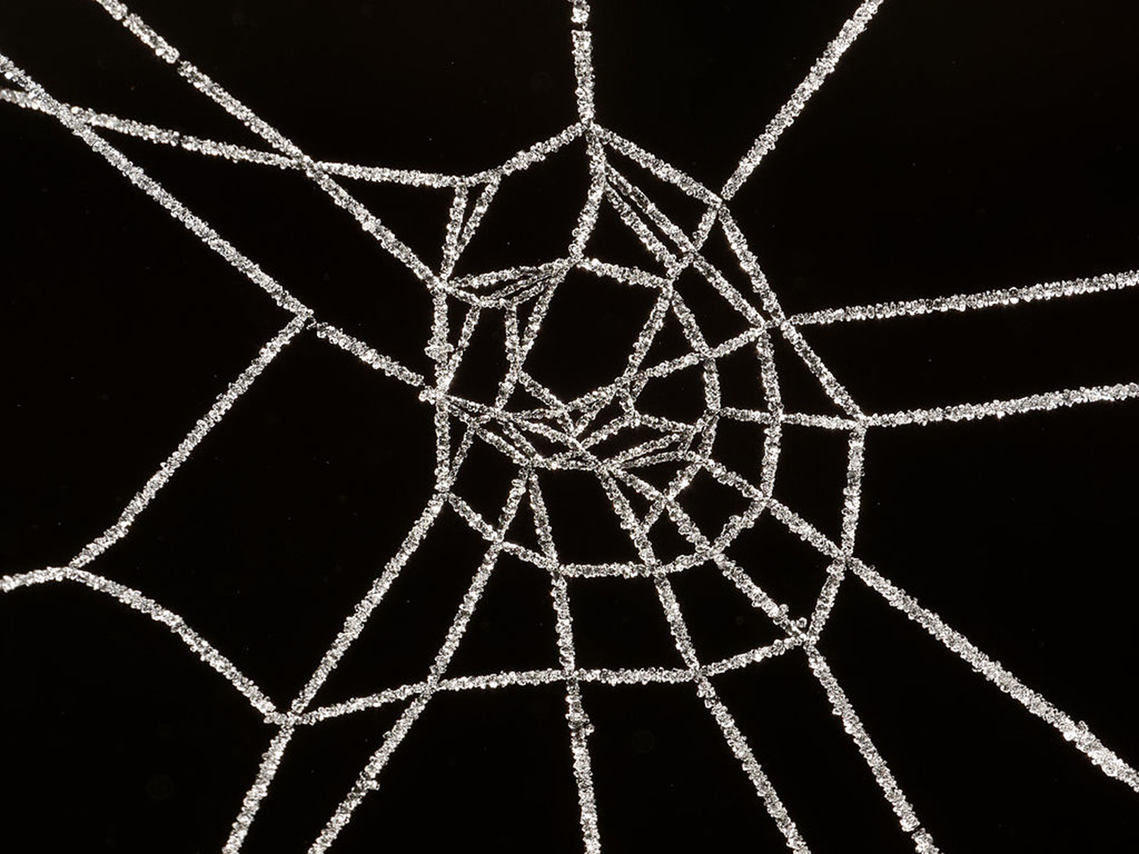
Problem Solving
Approaches to

Slide 19
Revising the Problem Solving/Design Paradigm . . Is this paradigm shift ?

Slide 20
For next time
Untill everyone has gained access to out class Open Lab site . Assignments will be circulated via email.
Our reading for next week will investigate our experience of weather and climate in NYC.
Have a great weekend and keep an eye on your
Citymail email addresses

